Slide 1
Software Testing Methodologies
Prashant Joshi

Slide 2
Approaches & “View”
Purpose is to uncover defects
Demonstrate the system works (Treat this as a by-product!)
Validate that it functions per specifications
Works as specified – always!

Slide 3
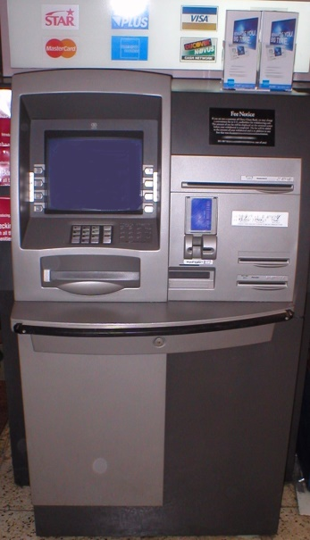
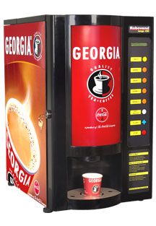
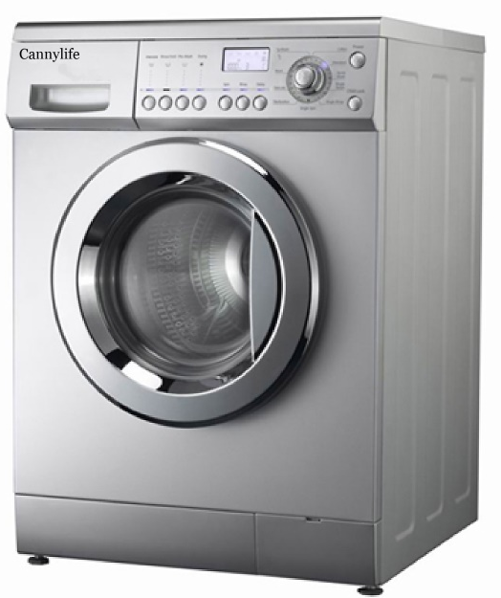
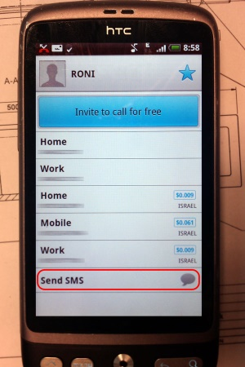
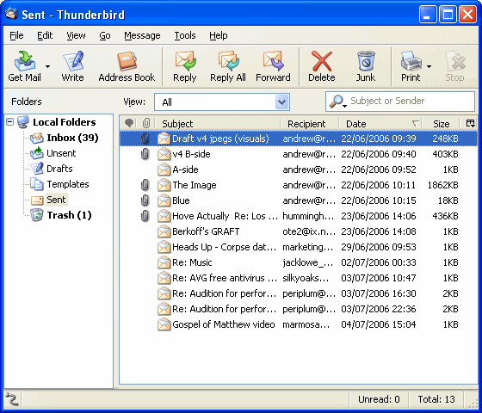
Examples
Automated Teller Machine
Tea/Coffee Vending Machine
Washing Machine
Contacts – Mobile Phone Application
Messaging – Mobile Phone Application
Email – Webmail/App/Client
…

Slide 4
What is it?
It is a systematisation of the Equivalence Partitioning and Boundary Value Analysis
Introduces concept of Test Specification which allows the test engineer to take a closer look at the specifications
Allows division of tasks for larger systems

Slide 5
Category Partitioning Method
Systematic approach to generation of test cases from requirements
Mix of manual and automated steps
Ref: T2 Chapter 3 Section 3.5

Slide 6
CP Method Steps
Analyse Specification
Identify Categories
Partition Categories
Identify Constraints
(Re) write test specification
Process specification
Evaluate generator output
Generate test scripts

Slide 7
Need of Combinatorial
Software to be test in various environments
Various combination factors
Need for combinations of inputs
Application
High Reliability needs
Work on various configurations (Windows, Mac, Linux)
Interoperability
Various Clients & Servers (MMS)

Slide 8
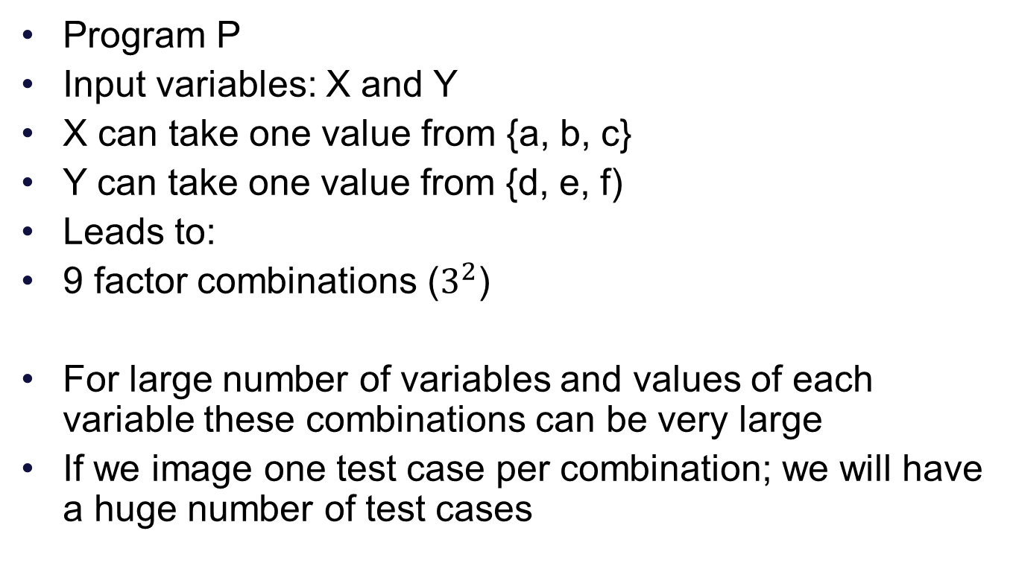
Modelling The Input
Program P
Input variables: X and Y
X can take one value from {a, b, c}
Y can take one value from {d, e, f)
Leads to:
9 factor combinations ($3^{2}$)
For large number of variables and values of each variable these combinations can be very large
If we image one test case per combination; we will have a huge number of test cases

Slide 9
Model the input
Fault Model (Interaction Faults)
Two or more variables play a role
One or more specific values play a role
Unique combinations
Latin Squares
Pairwise Testing
Orthogonal Array

Slide 10
Decision Tables
One of the most systematic approaches of designing Test Cases
Decision Tables are rigorous – enforce logical rigor
Related Method – Cause Effect Graphing
Ideal for situations with number of combinations of actions are taken under varying sets of condition
Structure of describing rules
Steps
Specifications
Decision Table
Test Cases

Slide 11
DT Technique
T: True
F: False
---: Don’t Care
<blank>: Not applicable
X: Action takes place
Notion of completeness
N conditions ➔ 2^{N} rules
Actions can be defined by user

Slide 12
Test Techniques
Equivalence Class
Boundary Value Analysis
Domain Partitioning
Combinatorial
Decision Table

Slide 13
Examples – Solve them
TV Remote Control Software
Software is designed for the remote control which has typical controls and options. Using DT design and develop test cases
A web based shopping cart checkout logic
By number of items
By weight of items
By value of items

Slide 14
Examples – Solve them
An insurance renewal premium
By Age
By Number of claims
By Value of claims
Folder and File Name generation for a Digital Camera
Use of a Serial number
Use of Date
Use of Date+time

Slide 15
Browsers on Operating Systems
Browsers (Firefox, Chrome, Safari and MyBrowser) are to be tested on various operating systems (Windows, Linux) and on various platforms like PC, Mobile. On Mobile phones the operating systems to be considered are (iOS, WP8, Android)
Come up with a strategy and test cases

Slide 16
School Attendance System
An attendance sub-system is developed which is part of a School Management System. At the beginning of the year the Class teacher creates the roster for the class by pulling in the details from Master Data Base. The fields that teacher uses are Full Name and Class/Division. Over that she builds a local database with entry of Nickname, Months of attendance, Attendance, Reasons for absence in case of absence (Sick, Informed Leave, School program, Competitions). Following reports are generated at the end of the week:
Classes attendance report
Student attendance report
Absenteeism report
Student absenteeism report
Design a set of test cases to test such a sub-system

Slide 17
Software Testing Methodologies
Prashant Joshi

